Slide 1
INTELLIGENT PUBLIC GRIEVANCE SYSTEM
PRESENTED BY
DEVYASH SANGHAI
SAMIR SHAH
Thakur College Of Engineering and Technology

Slide 2
Problem Definition To create an interface between Government Authorities and the general denizens using Web App e in Python. This interface will capture users complains. Users will be able to fill details of the nature of the grievance as well as photos. This application will also display nearby complains based on its dynamic parameters. It will show the user satisfaction on solution of their complains by the authorities. This data will be stored in a SQL database.

Slide 3
ABSTRACT
This application will be used to collect complaints from citizens of Kandivali east(Beta) and will be expanded to other locations in subsequent versions.
Citizens can register complaint on issues like potholes, garbage dumping in public areas, encroachment etc.
Citizens can register complaints directly from their smart phones via the Web app

Slide 4
Importance of Project
Intelligent public grievance system provides us with information that is critical in determining the satisfaction of the user.
This information that is mined would also provide the government data regarding efficient work of the officials.
After citizens report the BMC can prioritize and repair potholes efficiently.
It can collect feedback of users and take necessary actions post repairs.

Slide 5
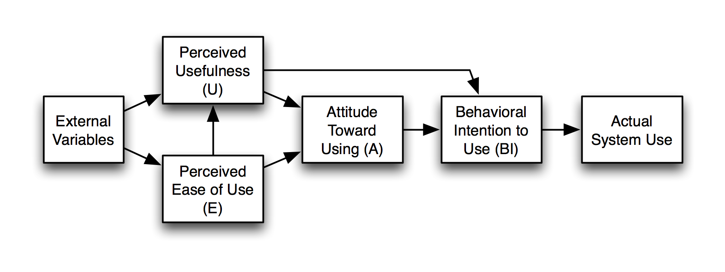
Literature Survey
Technology Acceptance Model (TAM):
The Technology Acceptance Model (TAM) is an information systems theory that models how users come to accept and use a technology. The model suggests that when users are presented with a new technology, a number of factors influence their decision about how and when they will use it.

Slide 6
Grand Successes and Failures in IT. Public and Private Sectors
These constructs were taken from the paper titled ”Examining the Factors Affecting Intention to Use of, and User Satisfaction with Online Public Grievance Redressal System (OPGRS) in India(SPRINGER)” by Nripendra P. Rana, Yogesh K. Dwivedi, Michael D. Williams.
System Quality:
Information Quality:
Perceived Usefulness:
User Satisfaction:
Intention of use

Slide 7
Motivation
Public grievances systems have existed for a long time. With every iteration these systems are only improving.
We came across the knowledge that this system is still in development.
Apart from this, Potholes are the major causes of nuisances faced by the denizens of our country.
Persistent efforts undertaken by the Government have proved to be futile.

Slide 8
Scope of project
This application suite comprises of various small application connected by common communication backbone.
This is a crowd sourcing application where input or issue will be logged by responsible civilian of the city. There would be one map based mobile application
This project is touted to be used by most of the smart phone users.

Slide 9
ANALYSIS AND PLANNING
Operational feasibility: User Interface will be extremely easy to use.
It will transparent providing users with the opportunity to see their as well as others complains.
Apart from this, the application would be easily used from people from all age groups.
Technical feasibility: Although, at first glance this project looks daunting. However, the aforementioned diagrams and descriptions make this project technically feasible

Slide 10
ANALYSIS AND PLANNING
Feasibility Study
Economic feasibility: The economic feasibility of this project is measured by the actual usage of the project.
The higher the usage of the application, the higher will be the cost of maintaining it. Since the application is a cloud application, it is highly scalable
Logical feasibility: This project is very well logically suitable as this project first targets our home country India. Since, India is a developing country with a population of 1.252 billion. The user base is huge.

Slide 11
CURRENT SYSTEM

Slide 12
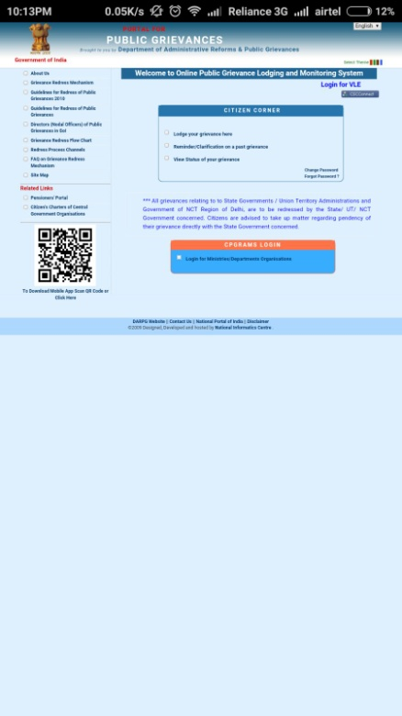

Slide 13
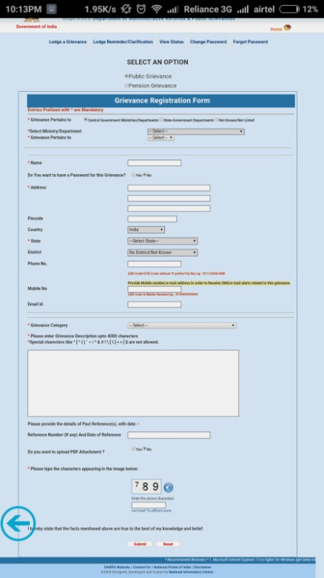

Slide 14
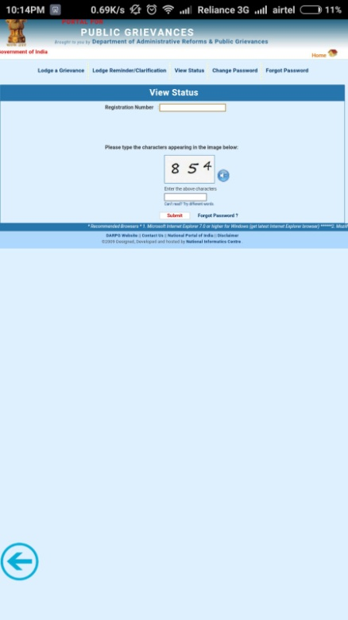

Slide 15
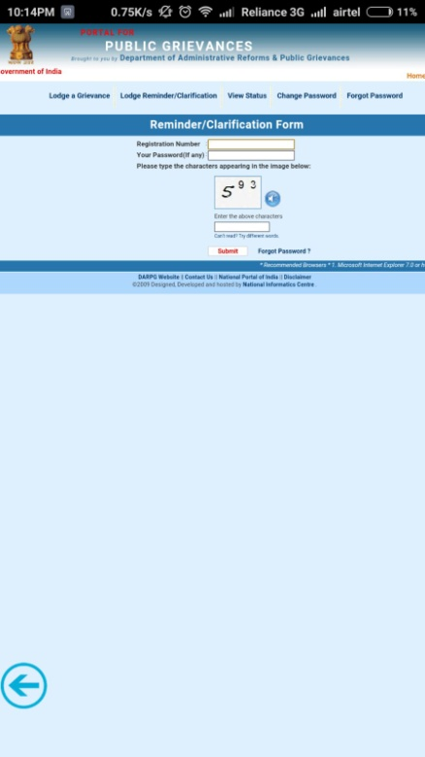

Slide 16
What makes us different?
Automation
Open
Hassel free
Quick
Concise
Design
PTLW(Pictures talk louder than words)
Data Mining (Further releases),
Goes along with our honourable PM’s Digital India Campaign

Slide 17
PROPOSED SYSTEM

Slide 18
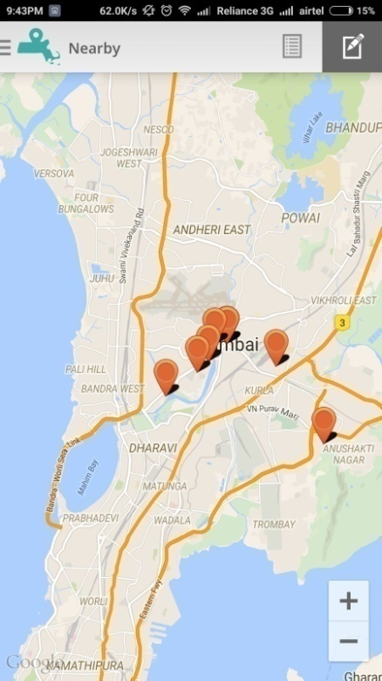
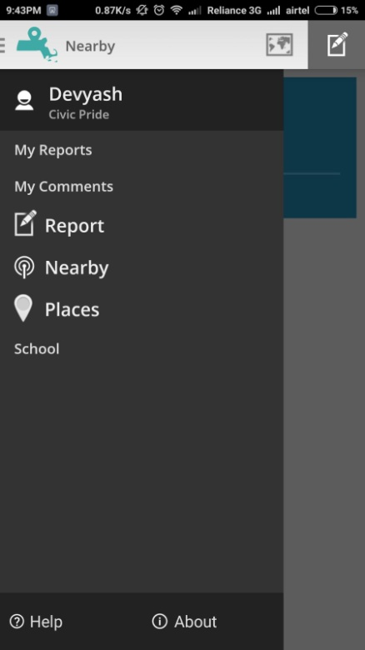

Slide 19
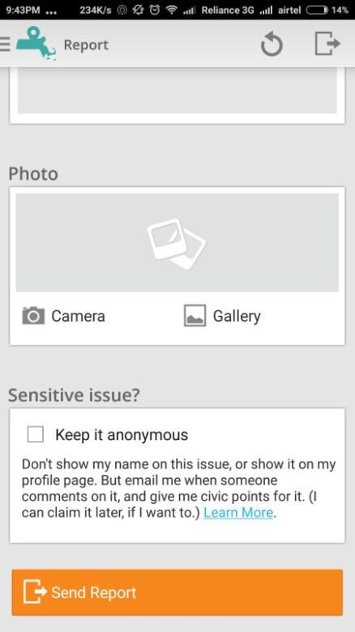
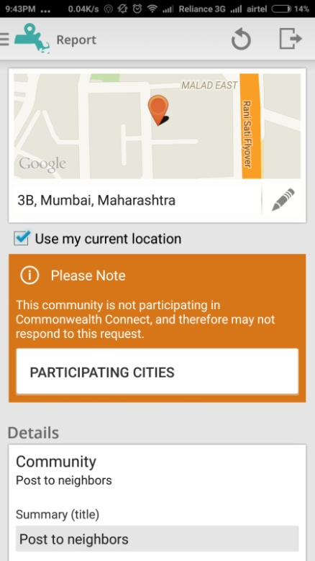

Slide 20
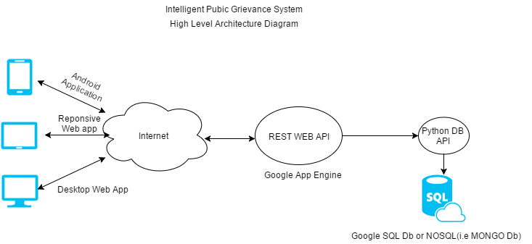
Architecture Diagram

Slide 21
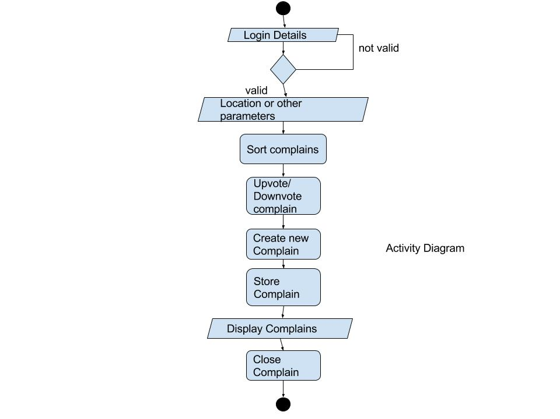
ACTIVITY DIAGRAM

Slide 22
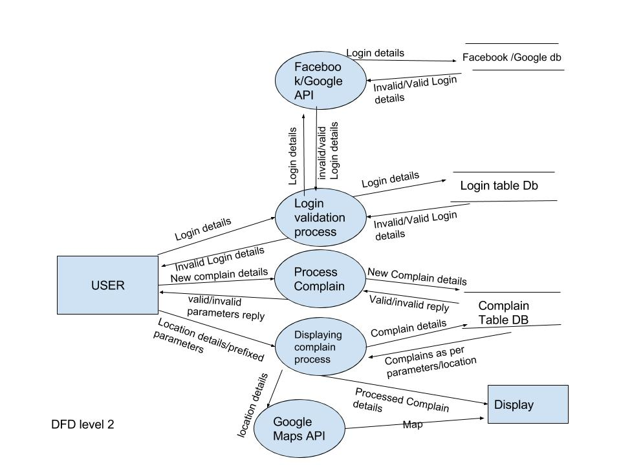
Data Flow Diagram

Slide 23
Proposed System.
This Intelligent Public grievance system as endeavored by us in our project will derive from present systems.
It will simplify the current Indian Public Grievance portal of the government of India by using the transparency of the common wealth connect.
At the same time, we intend to make this system smarter by using the data mining techniques that will predict the satisfaction of the citizens.

Slide 24
Working of the application
This app will require users to log in with Google accounts.
Later they can make official complaints by providing relevant if proof and OTP(Future).
Users can register a complaint by clicking a photo of the pothole, garbage dump, encroachment etc via the smartphone’s camera.
They can add the description of the complaint
Posts and photos can be geotagged.

Slide 25
Working(continued)
Users will be able to see existing complaints.
Users will be able to rate complaints(future release)
Complaints can be ordered on the basis of ratings by users(future release)
Data Mining to will be preformed on data for relevant facts(future release)

Slide 26
Technology used
HTML,CSS,JavaScript for front end application development.
SQL ALCHEMY for database management
Heroku for Cloud Storage(Further releases)
Google maps API for rendering maps on the application.
Hadoop for data mining(Further releases)

Slide 27
Tools used
Python 2.7 SDK
Web browser (Chrome, IE, Mozilla)
Sublime Text Editor
Virtual Environment
Github for version control
SQL Alchemy

Slide 28
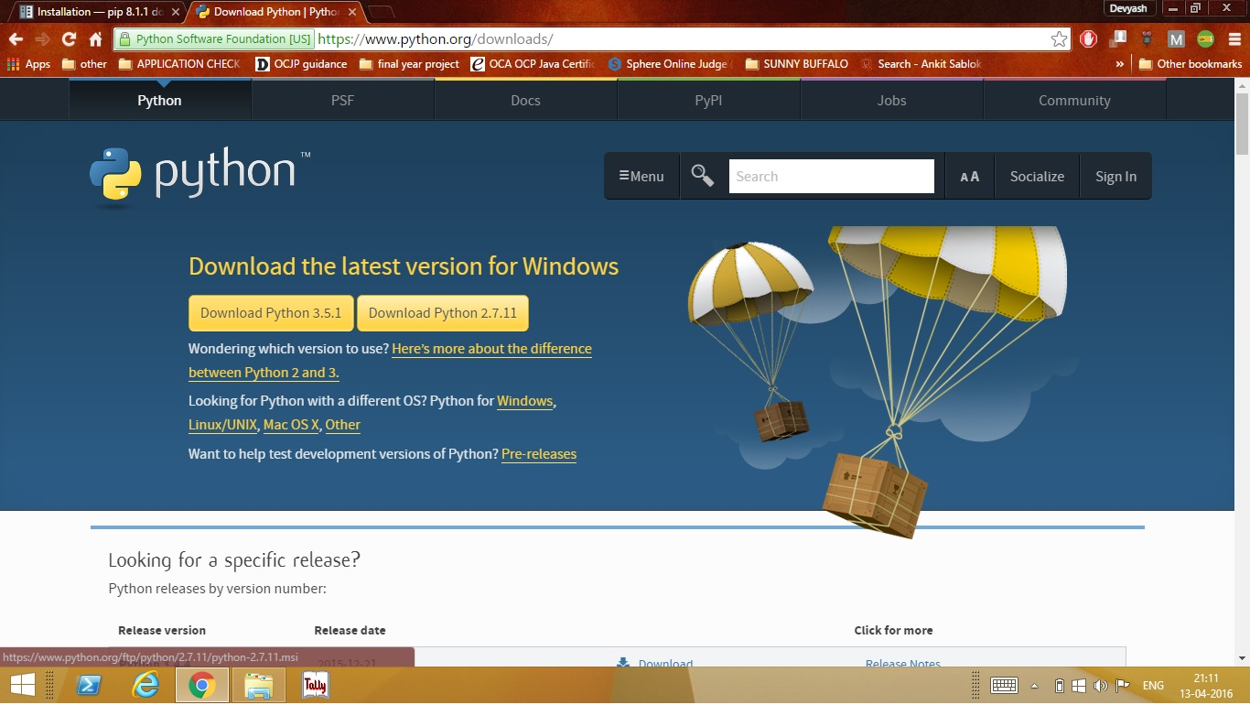
:
PROJECT SETUP:
Install Python 2.7

Slide 29
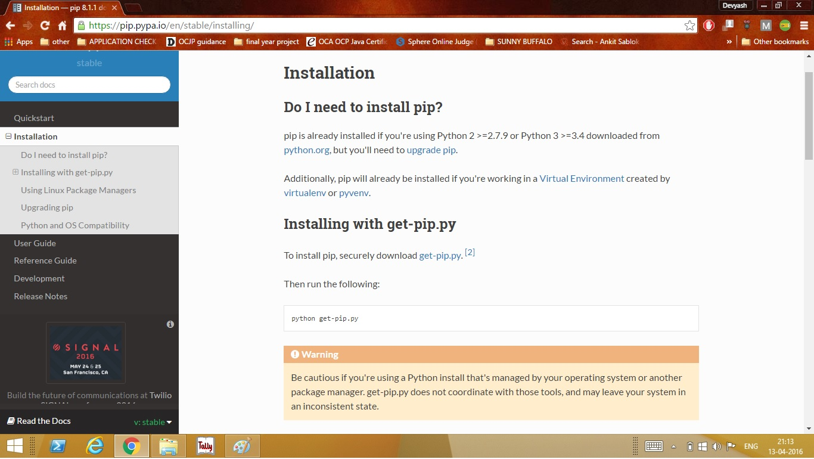
Install Pip: Visit the website below

Slide 30
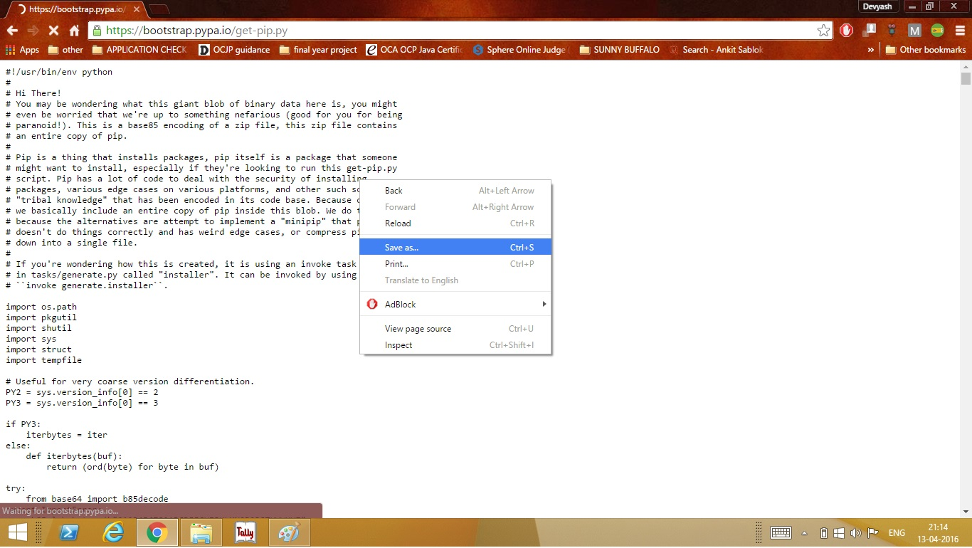
Click on get-pip link:

Slide 31
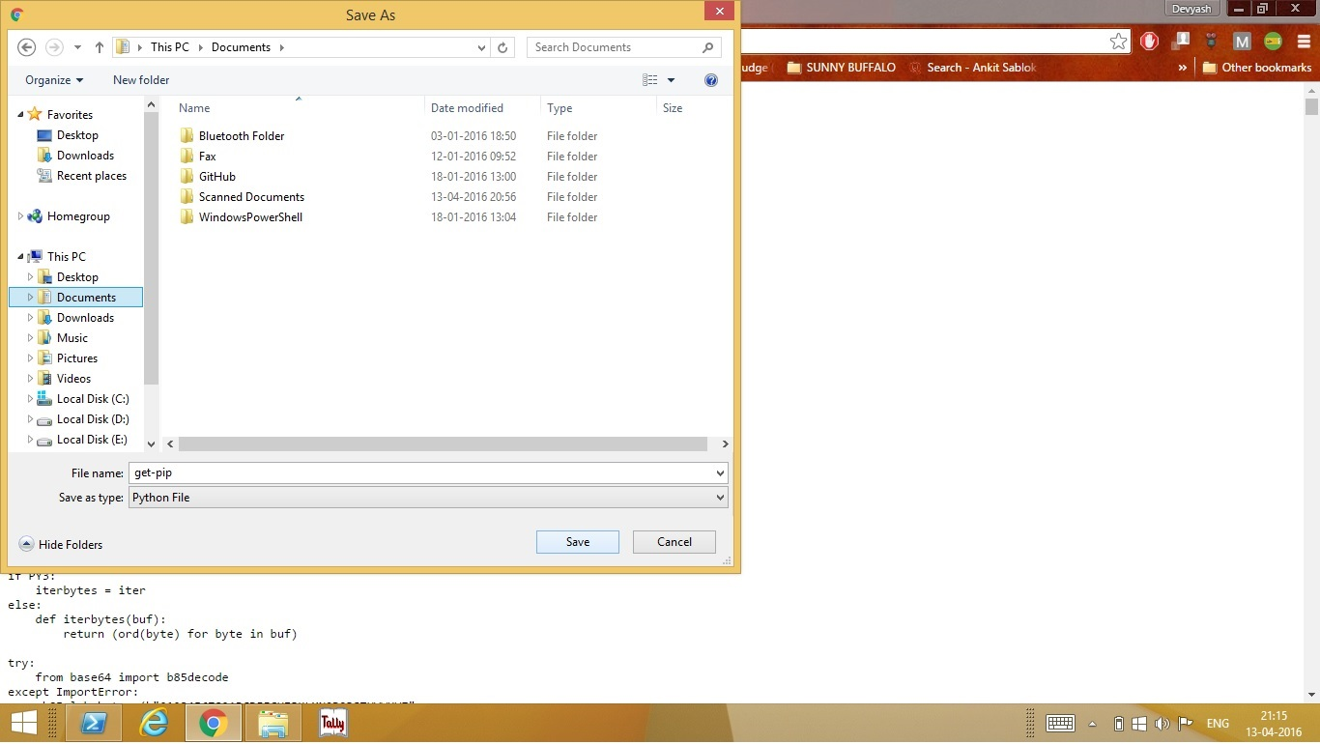
Saving the the get-pip script:

Slide 32
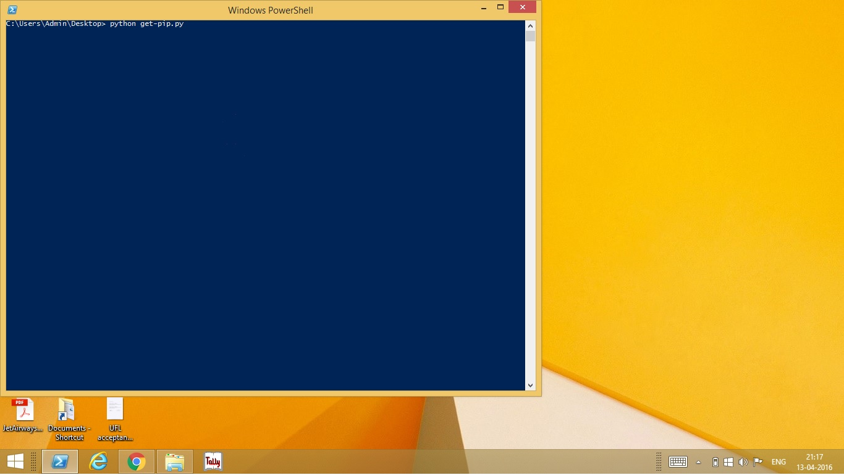
Run the get-pip python script:

Slide 33
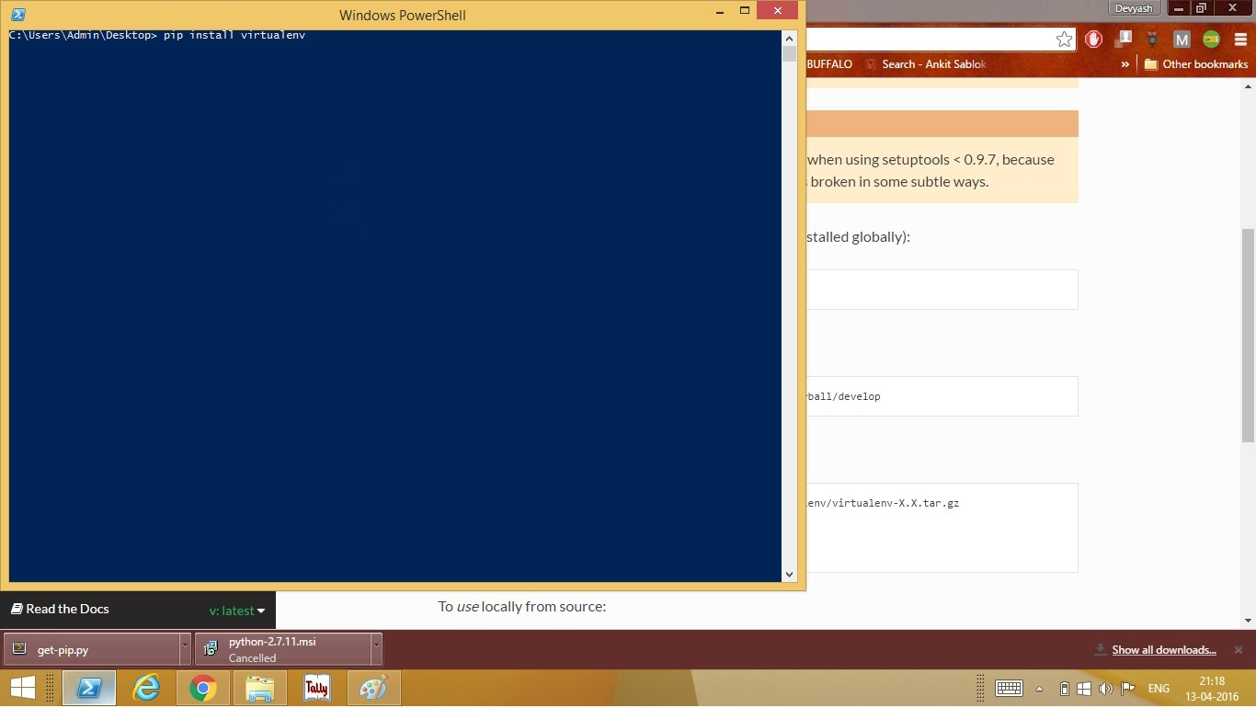
Installing the virtual environment:

Slide 34
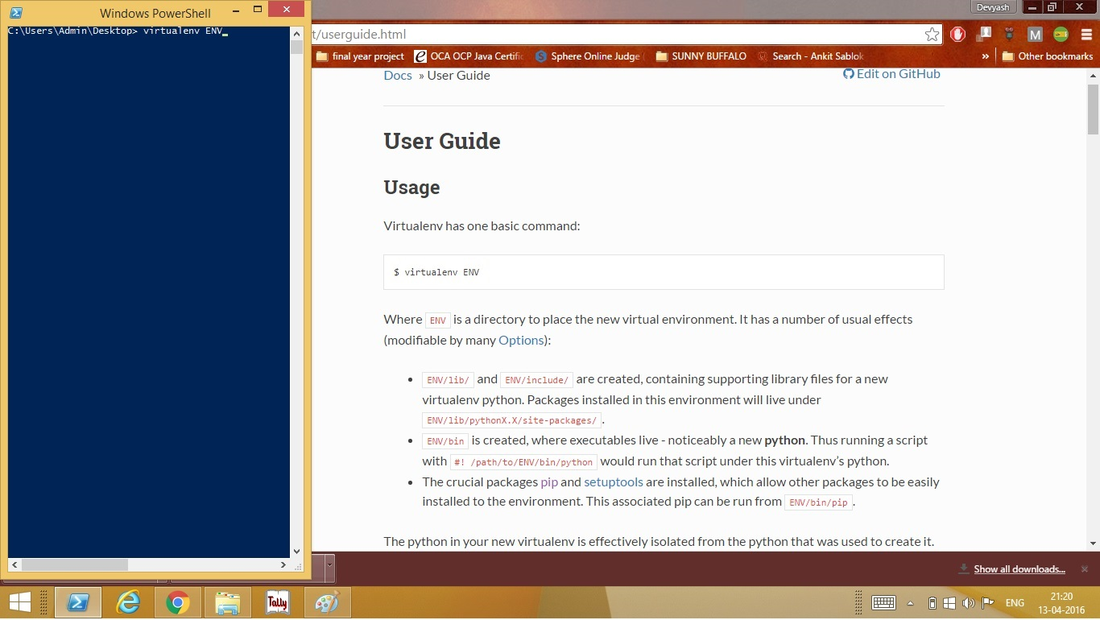
Instantiate a Virtual environment folder:

Slide 35
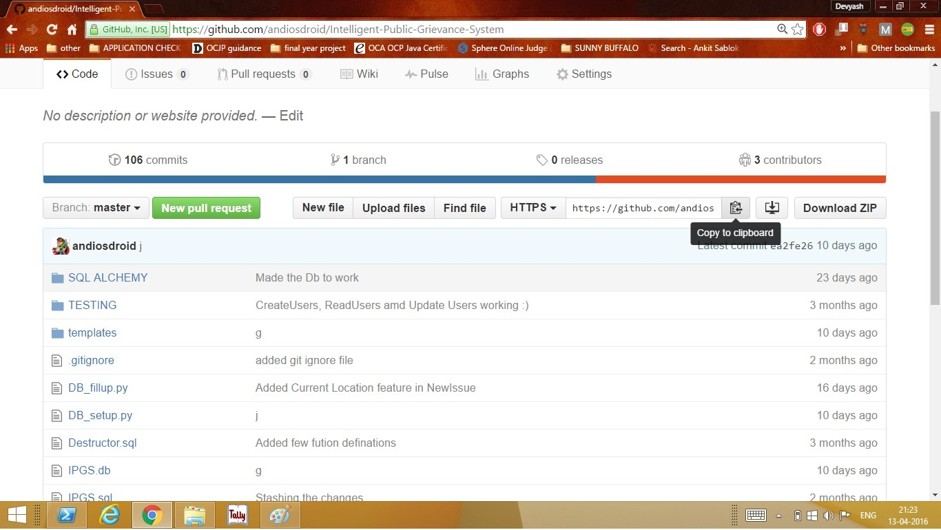
Download the source code of the project from github(Copy the link):

Slide 36
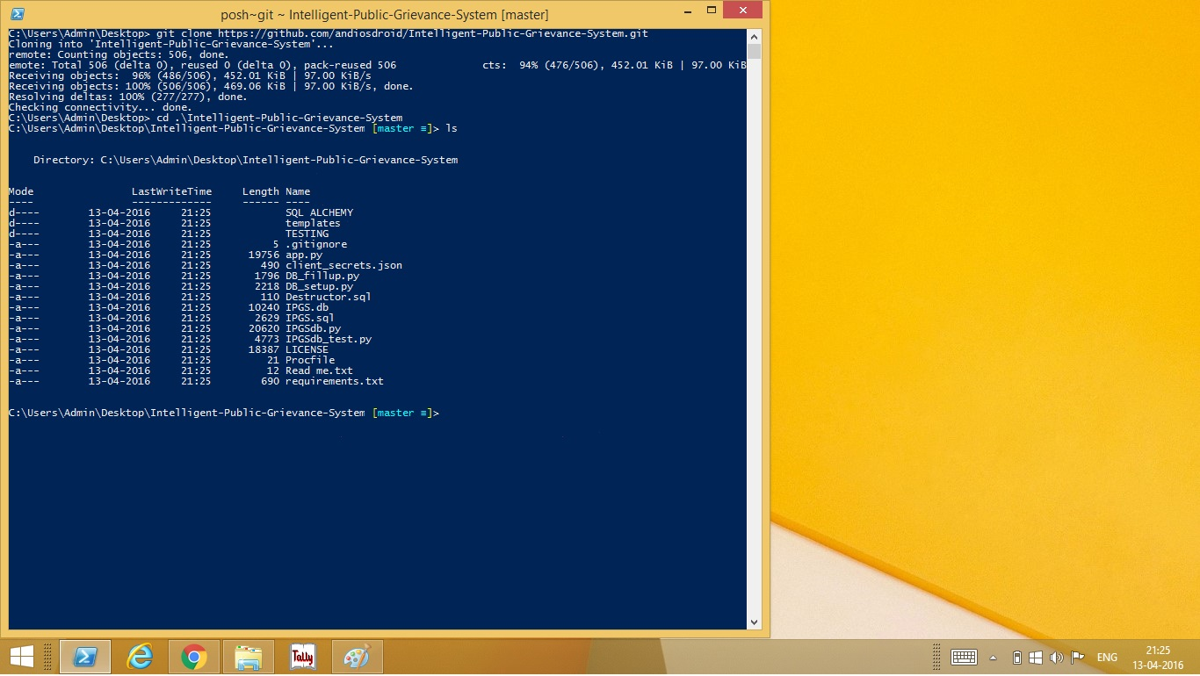
Use git clone to download the code:

Slide 37
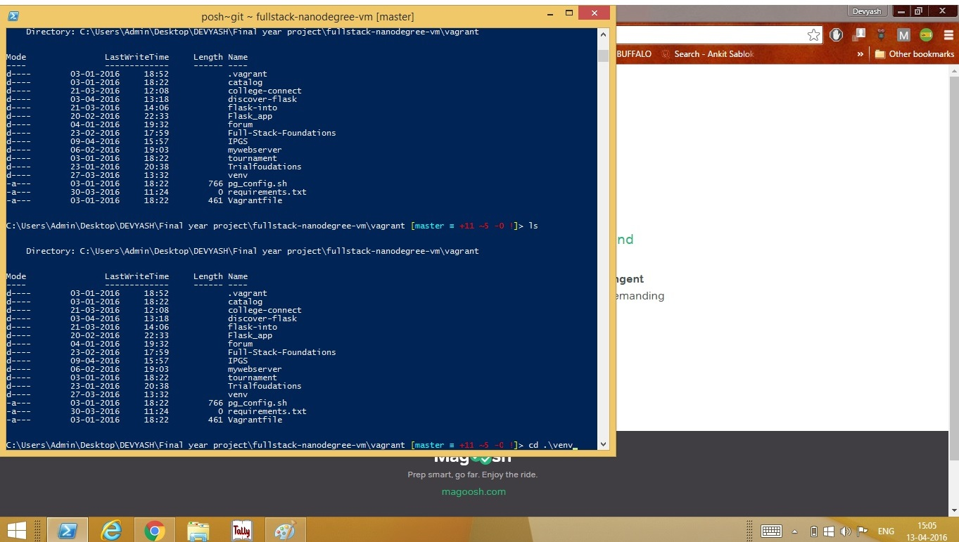
RUNNING THE WEBAPP ON LOCAL HOST
Change directory to virtual environment:

Slide 38
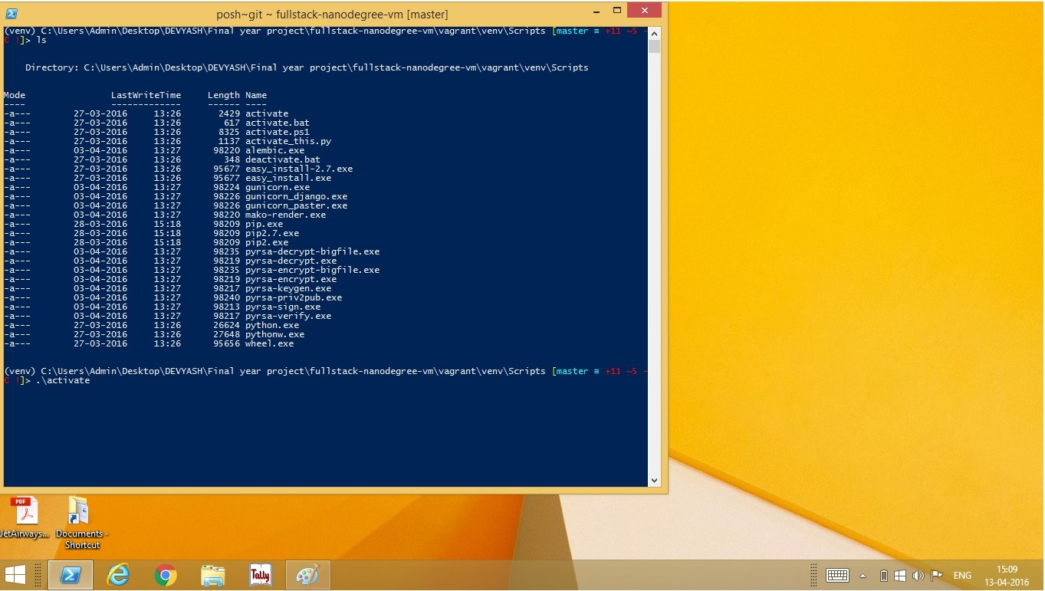
Activate the virtual environment:

Slide 39
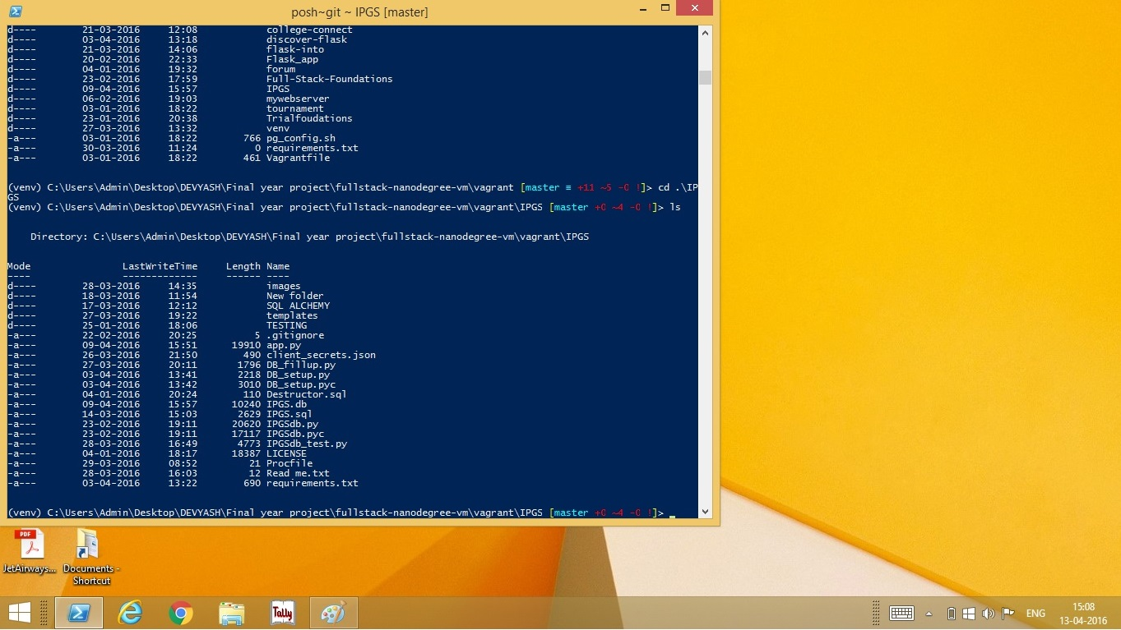
Navigate to Project folder using cd command in command line:

Slide 40
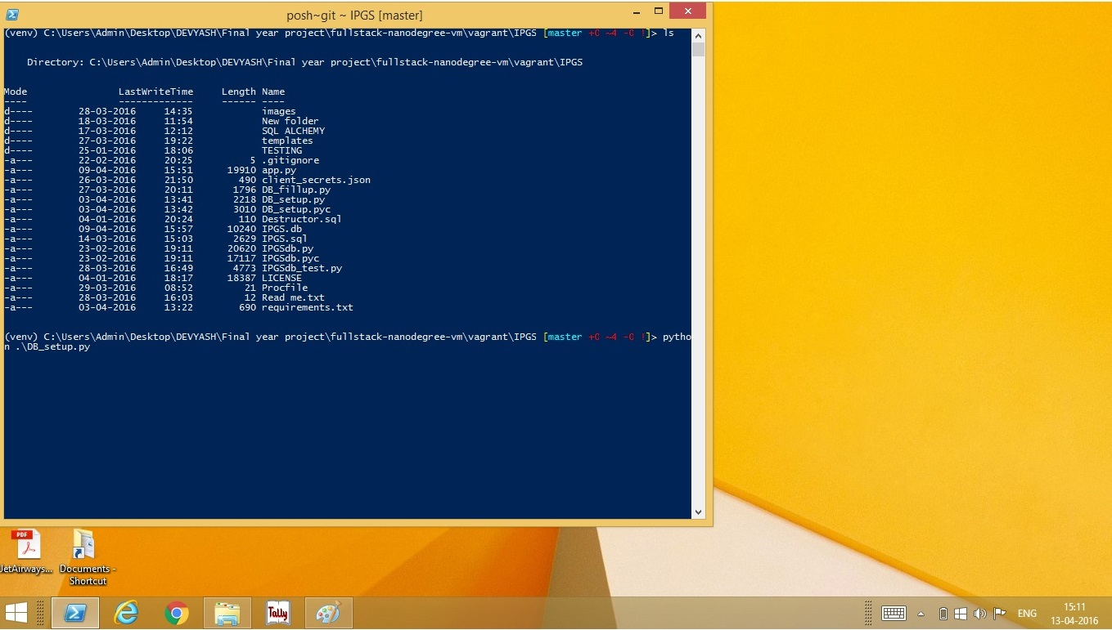
Set up the date base by running the DB_setup.py file :

Slide 41
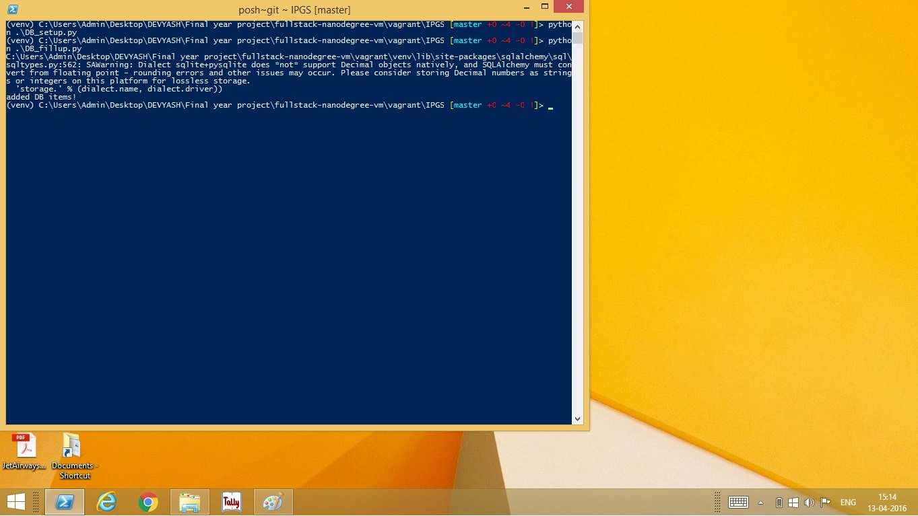
Fill the data with dummy data by running the DB_fillup.py file:

Slide 42

Run app.py file to start the Flask app server:

Slide 43
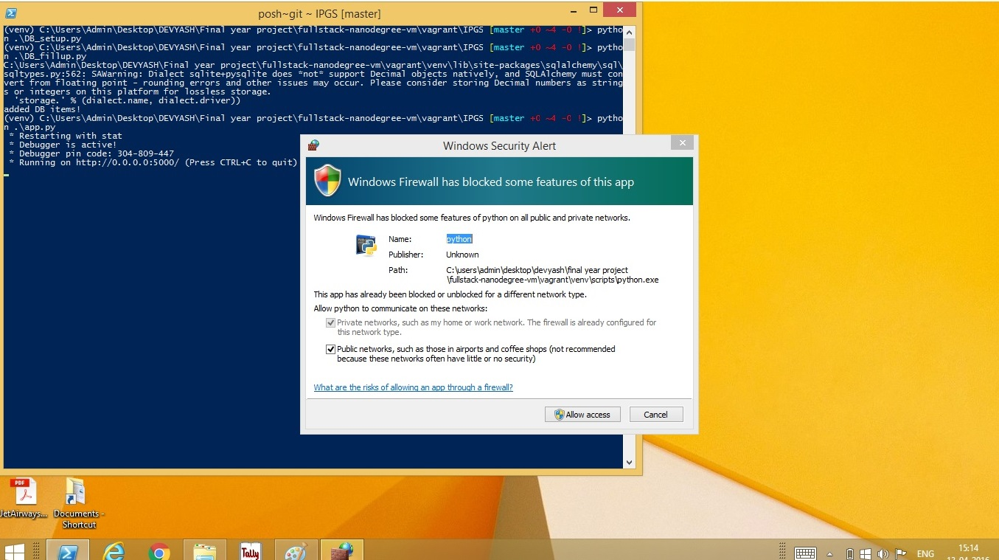
Allow network access:

Slide 44
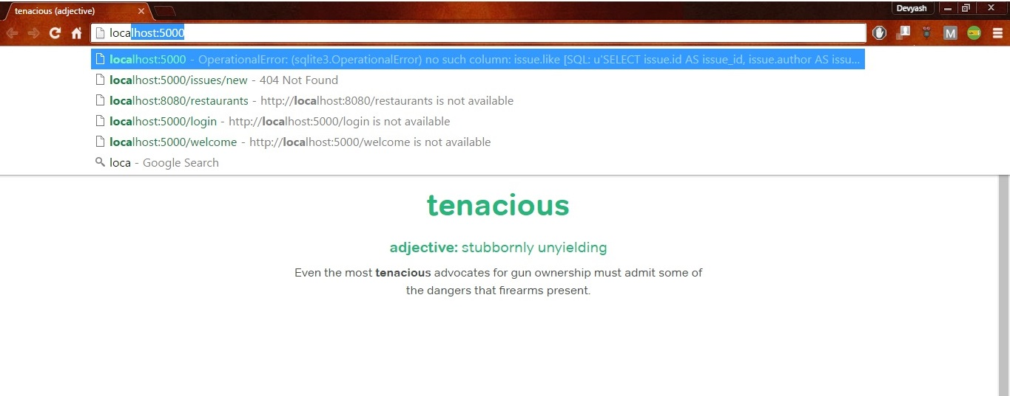
Open Local host in browser:

Slide 45
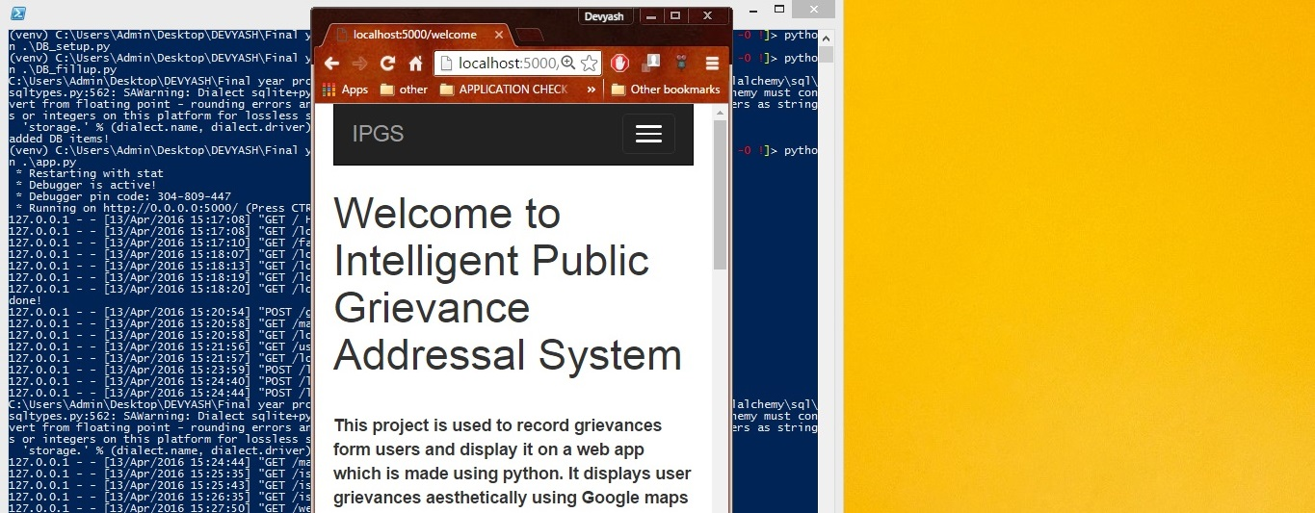
Fig 6.2.2.9) Redirected to Welcome Page:

Slide 46
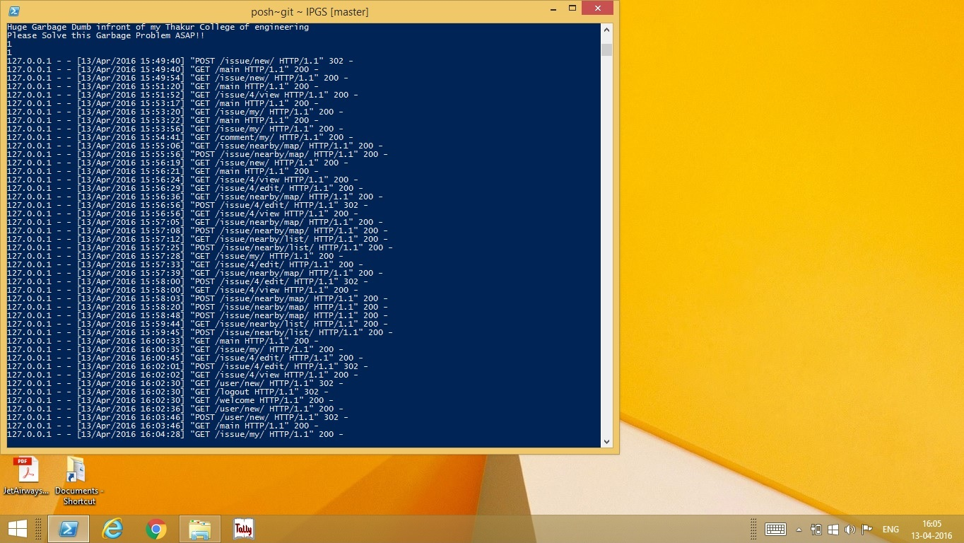
Fig 6.2.2.10) Server Logs:

Slide 47
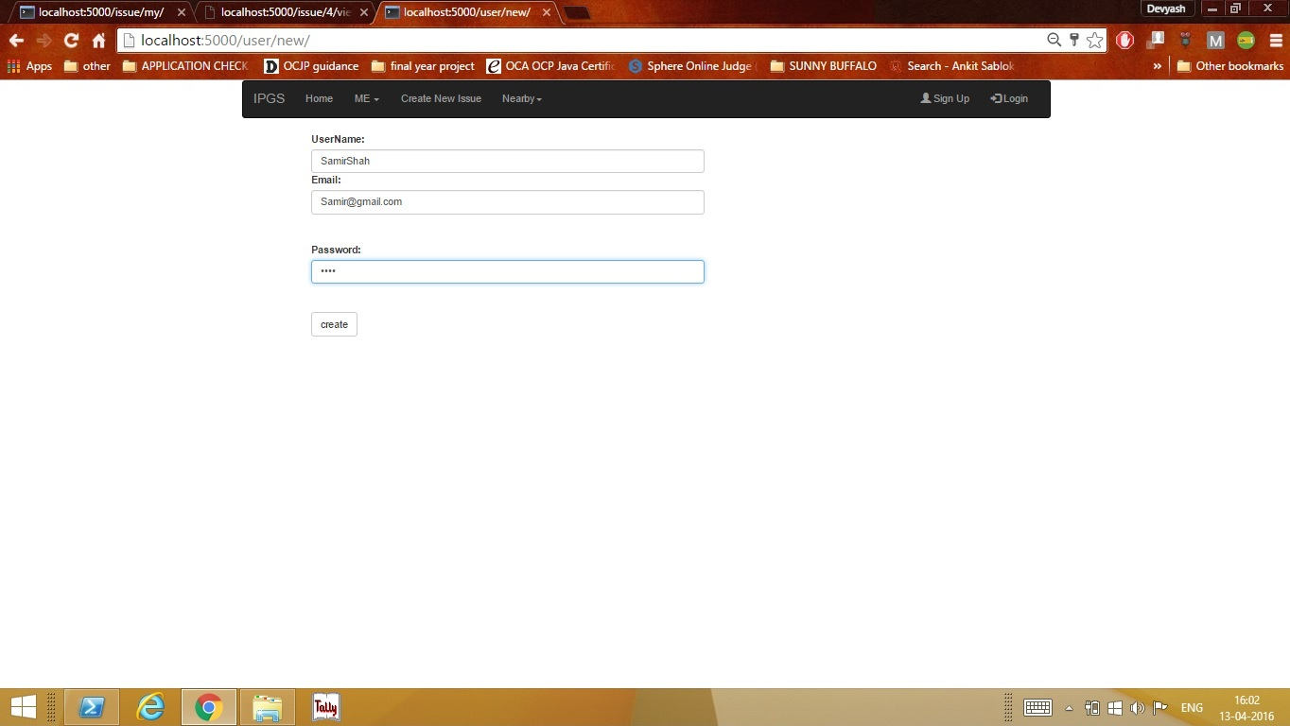
CREATE A NEW USER
Enter the details in the form:

Slide 48
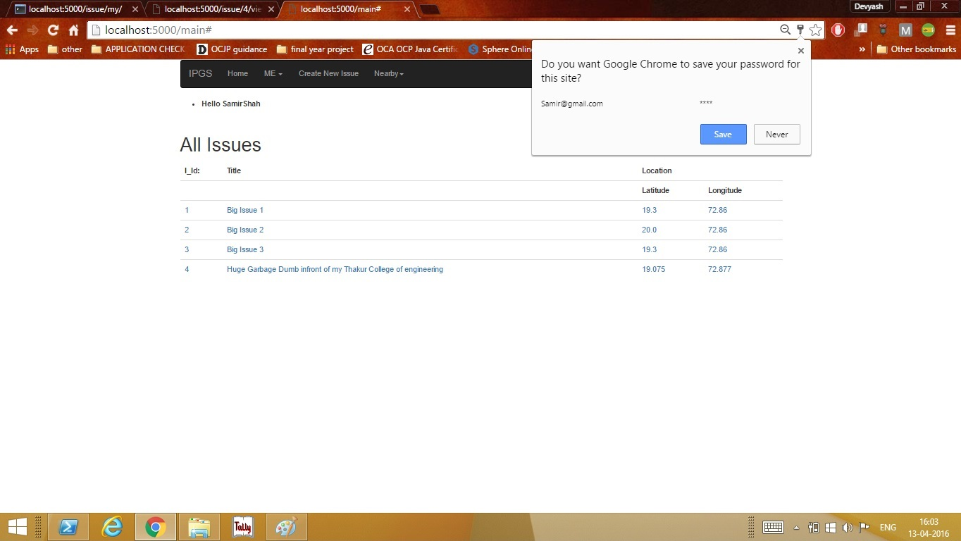
Click Create:

Slide 49
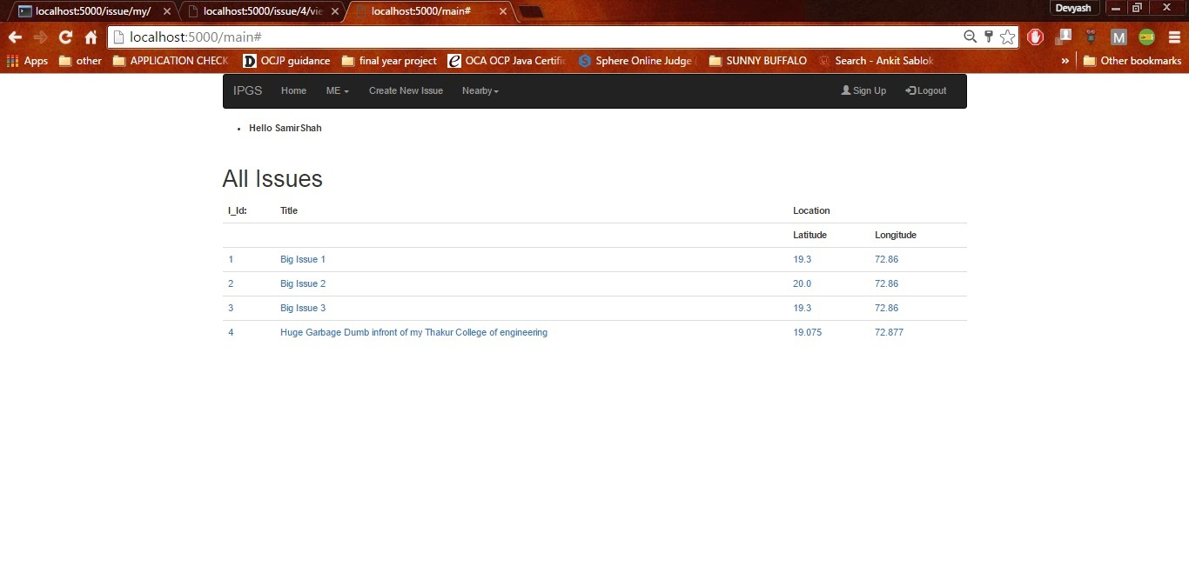
Logged in User:

Slide 50
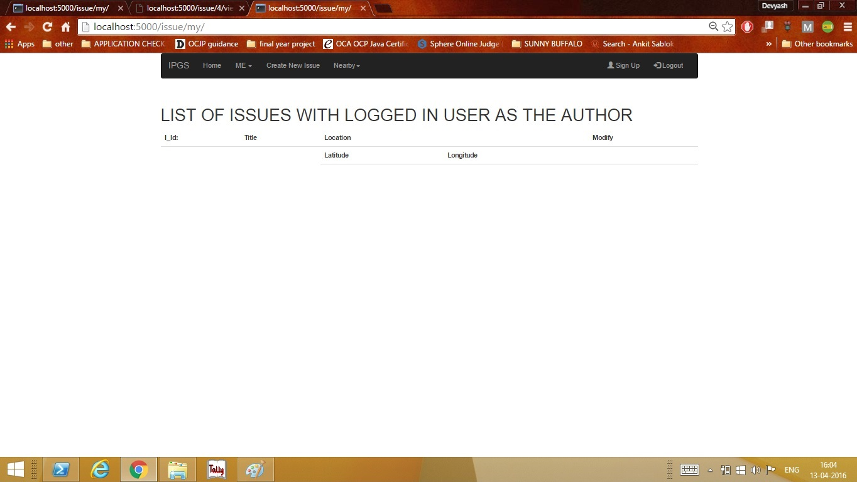
No complaints by the new user:

Slide 51
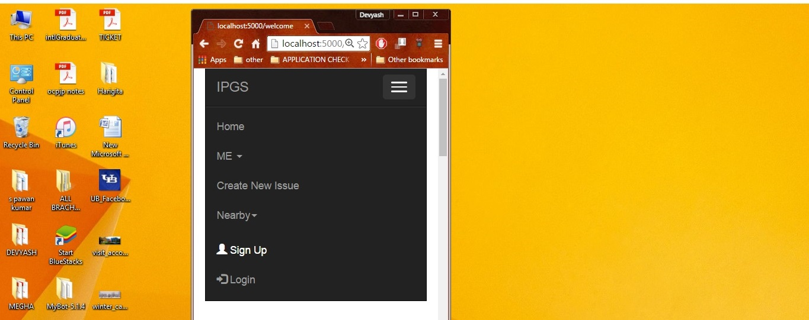
LOGIN
Mobile View of Homepage:

Slide 53
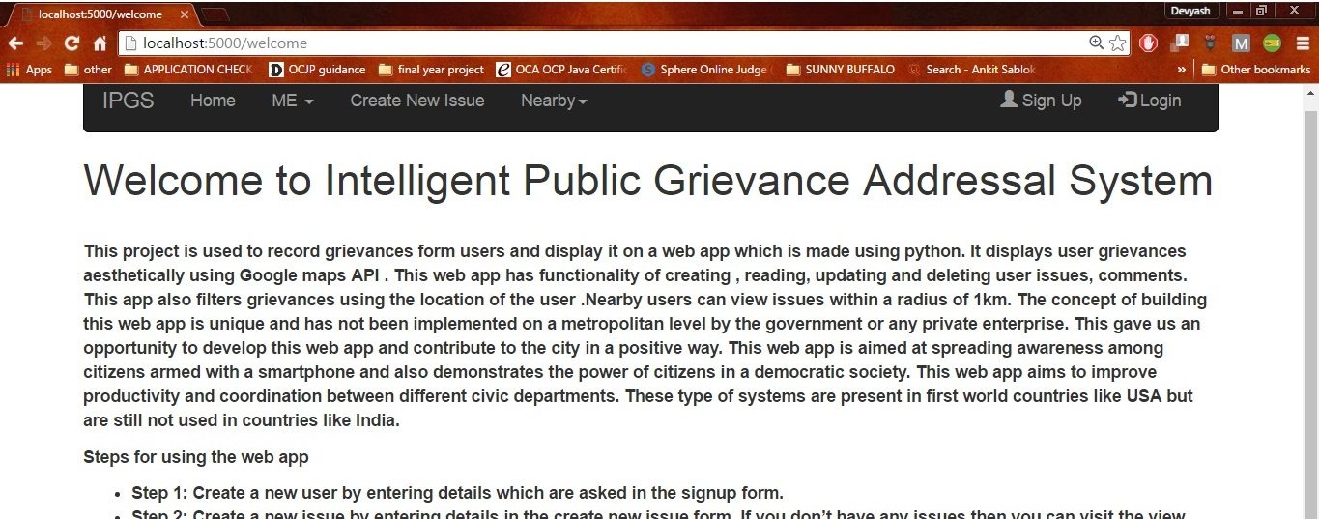

Slide 54
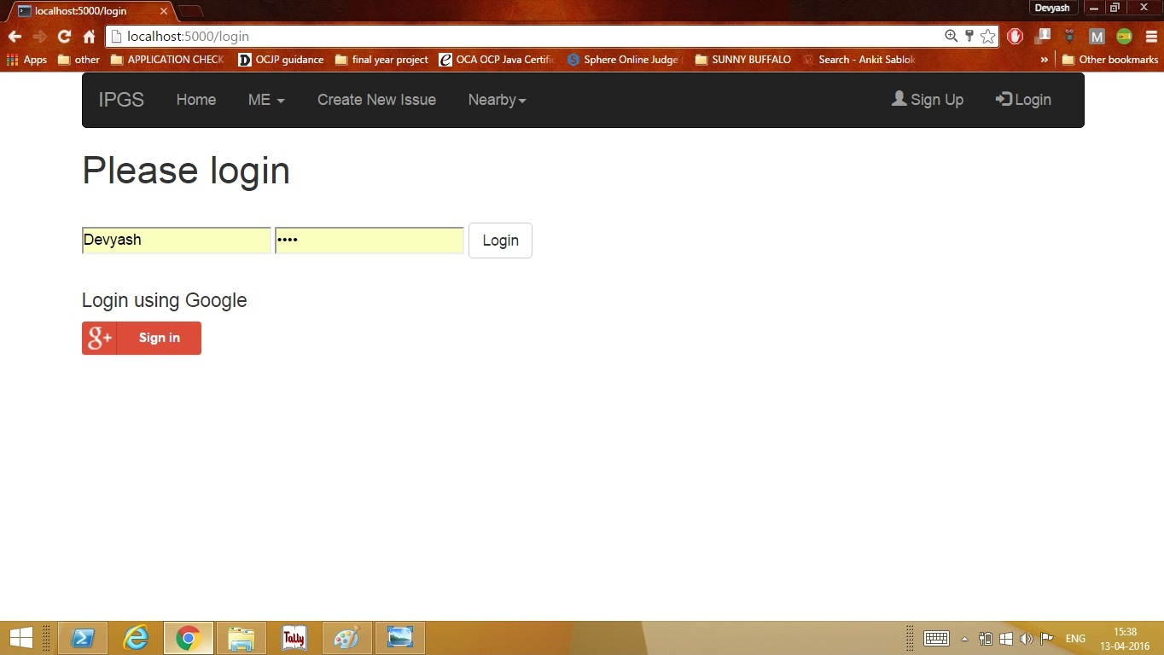
Login Page:

Slide 55
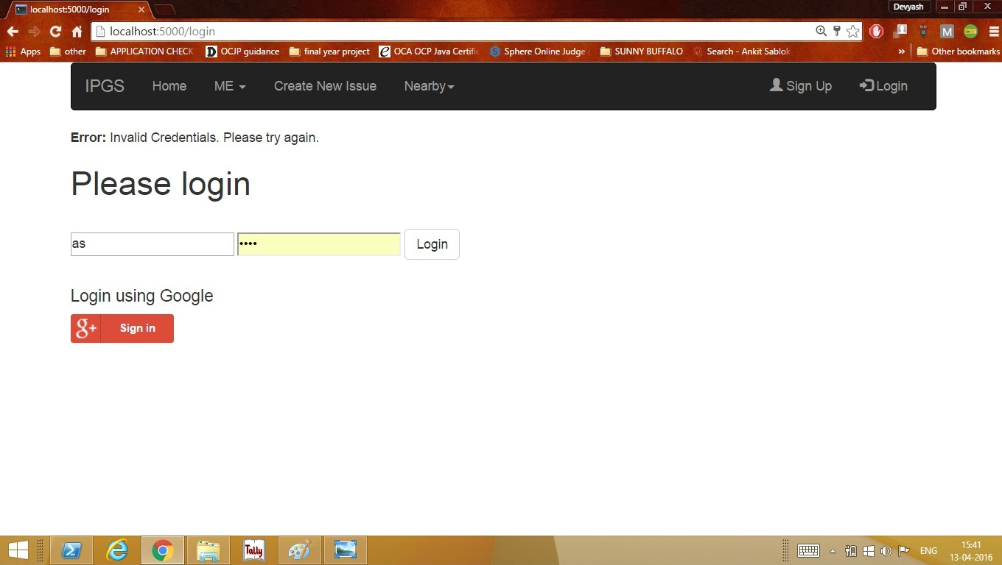
Entering Wrong Credentials:

Slide 56
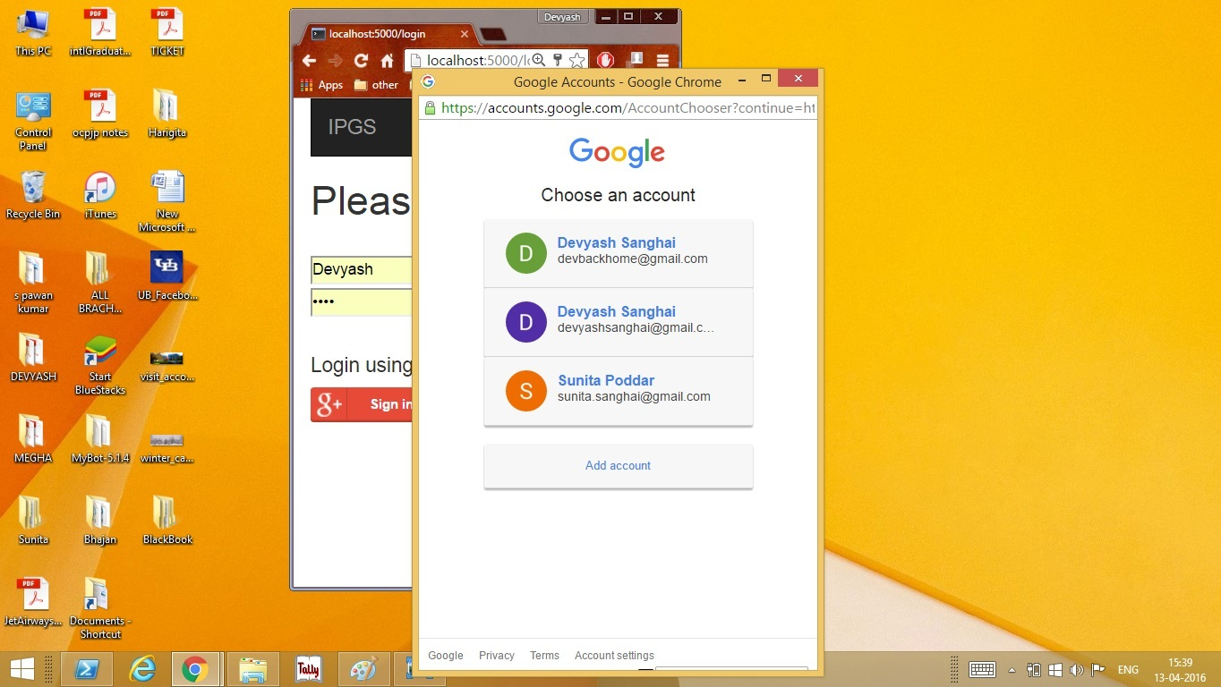
Grant User Permission to access the webpage:

Slide 57
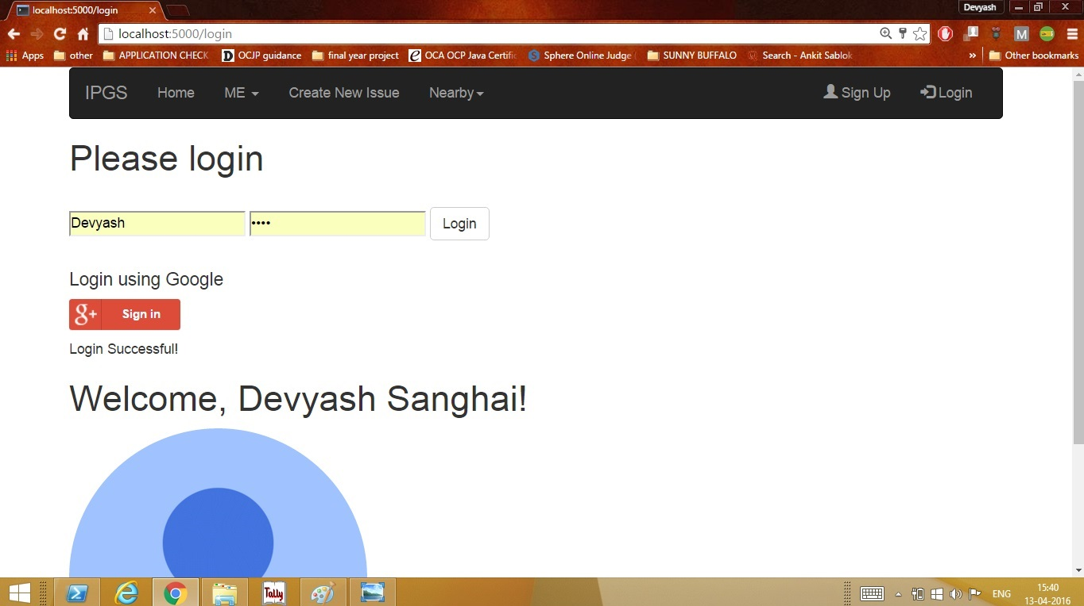
After Login :

Slide 58
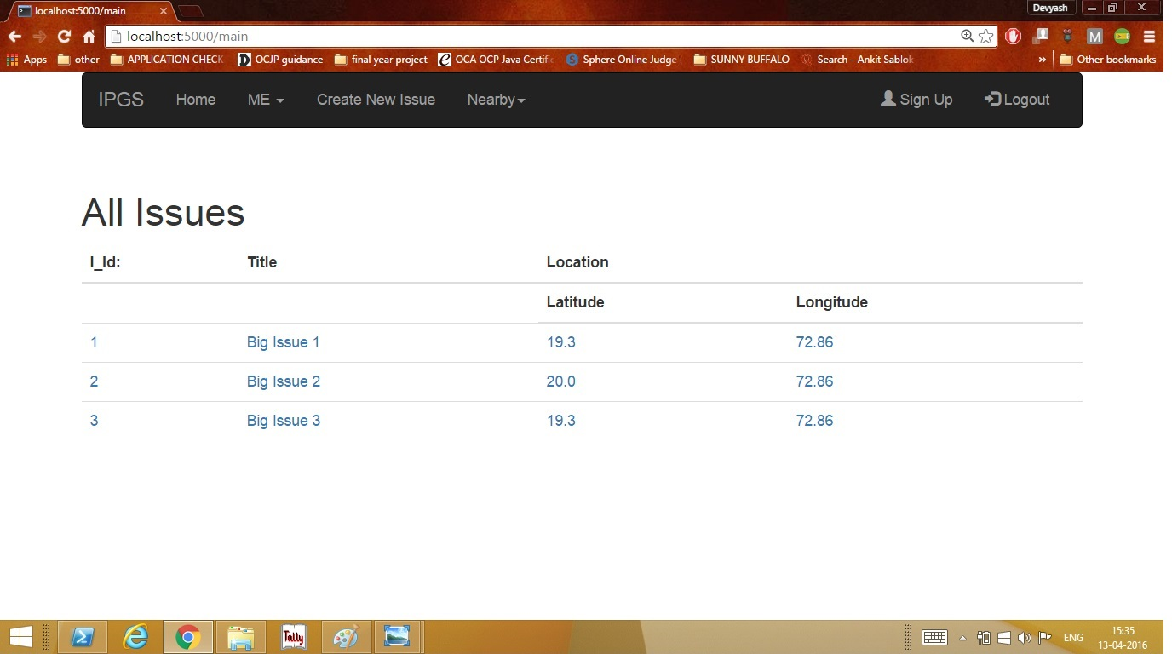
Directed to Home Page with all Issues:

Slide 59
CREATE NEW ISSUE:
Click on Create New Issue:

Slide 60
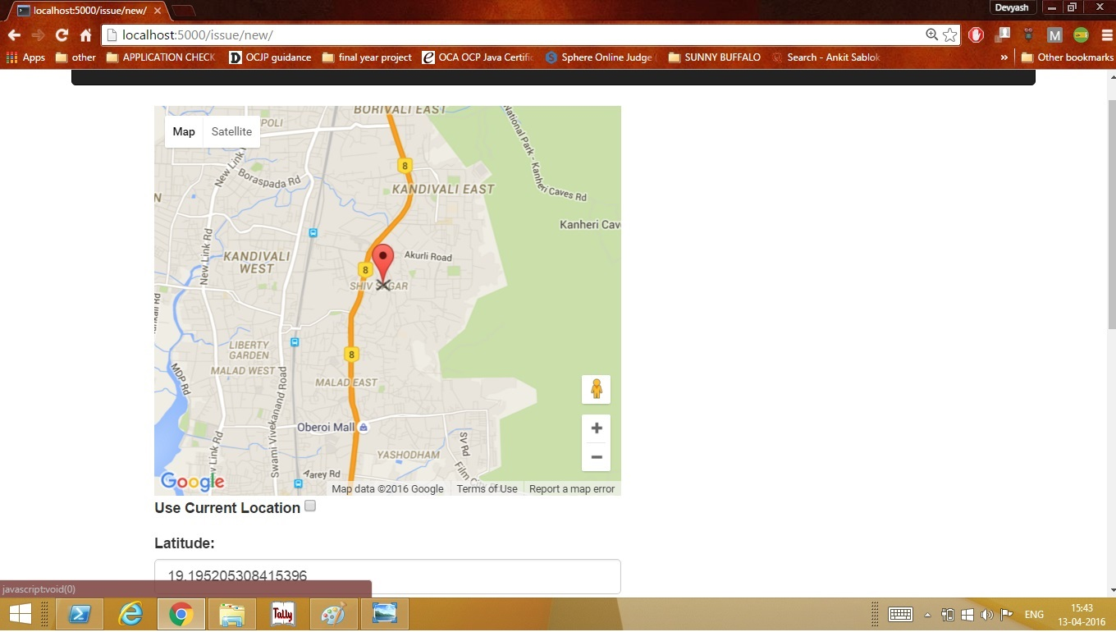
Drop the pin based on location:

Slide 61
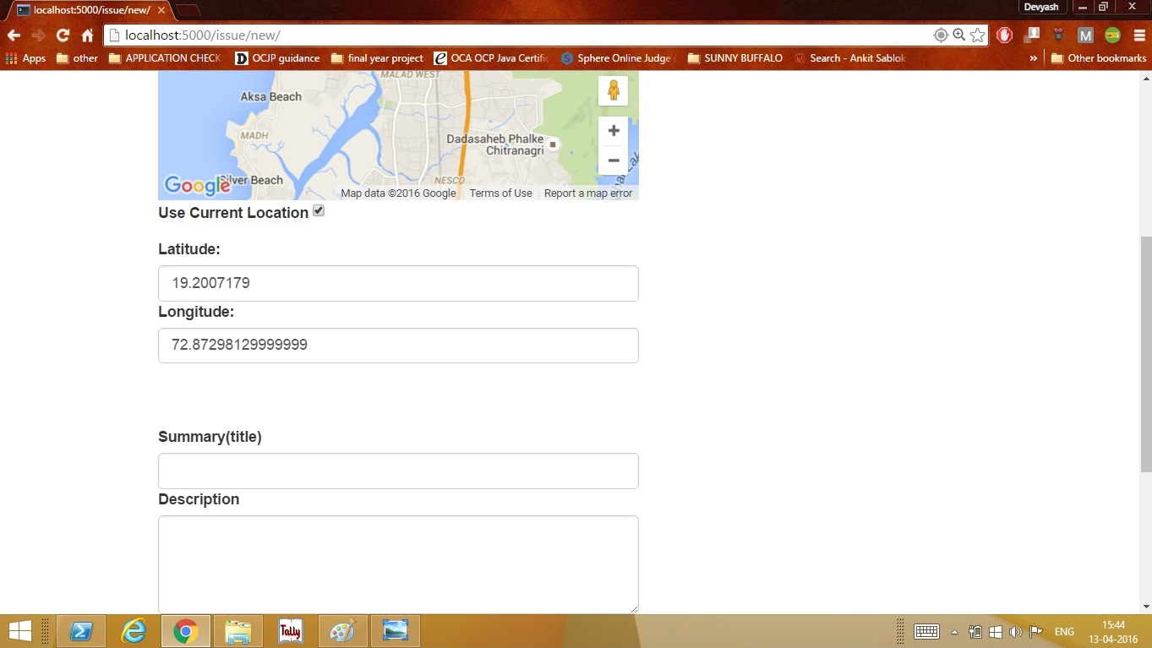
You can select your Location too:

Slide 62
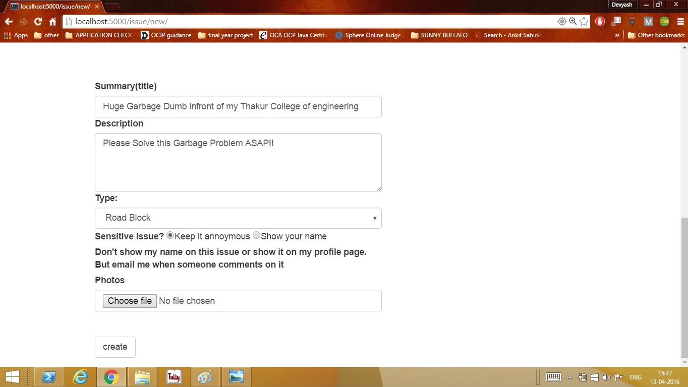
Enter other details and Select your name visibility:

Slide 63
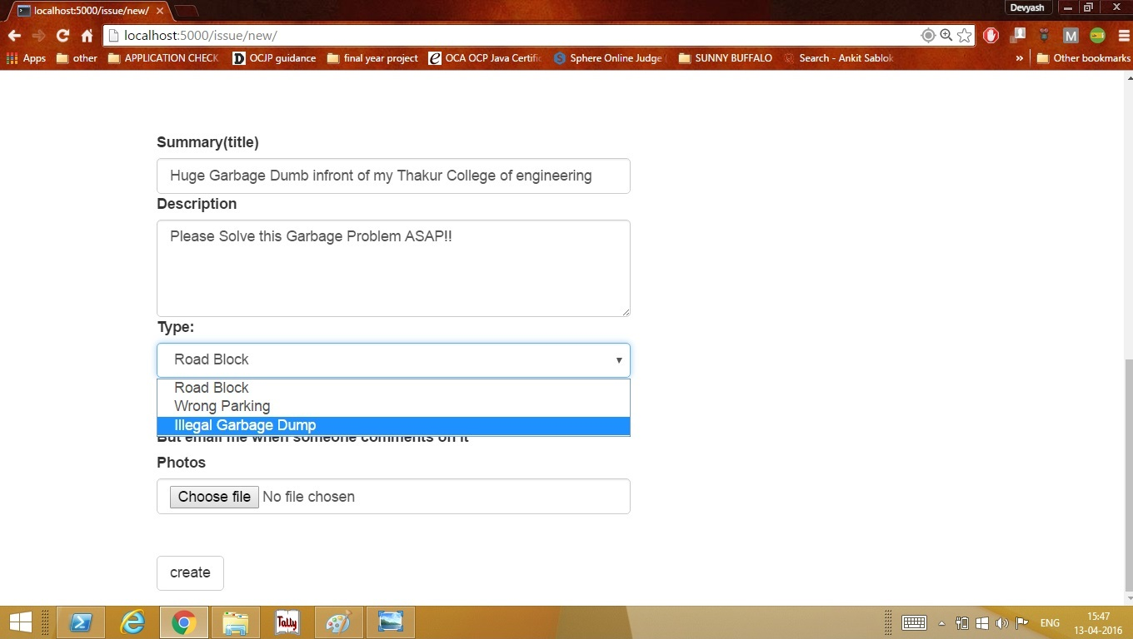
Select Issue type from the Drop Down:

Slide 64
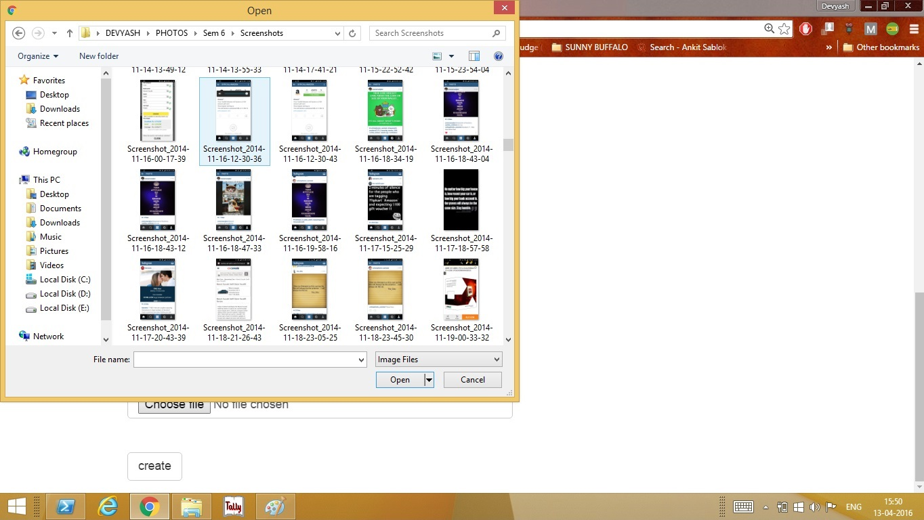
Select an Image of the complaint:

Slide 65
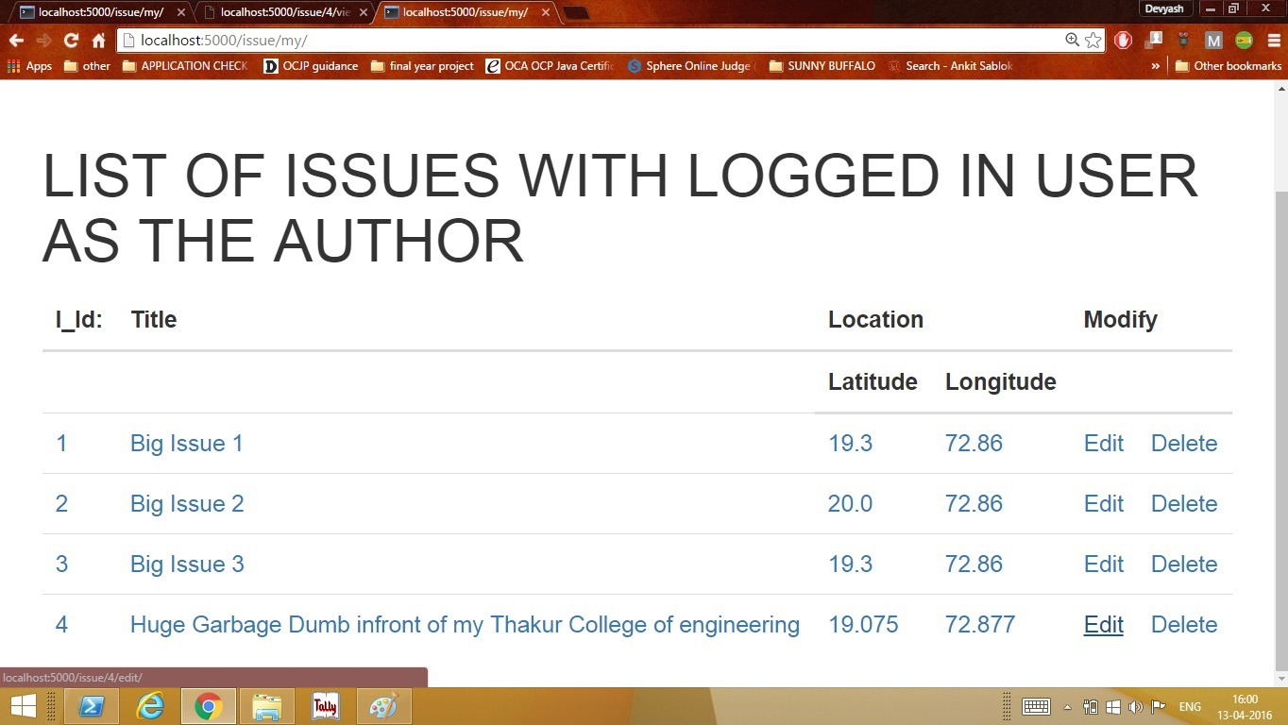
New Issue Added:

Slide 66
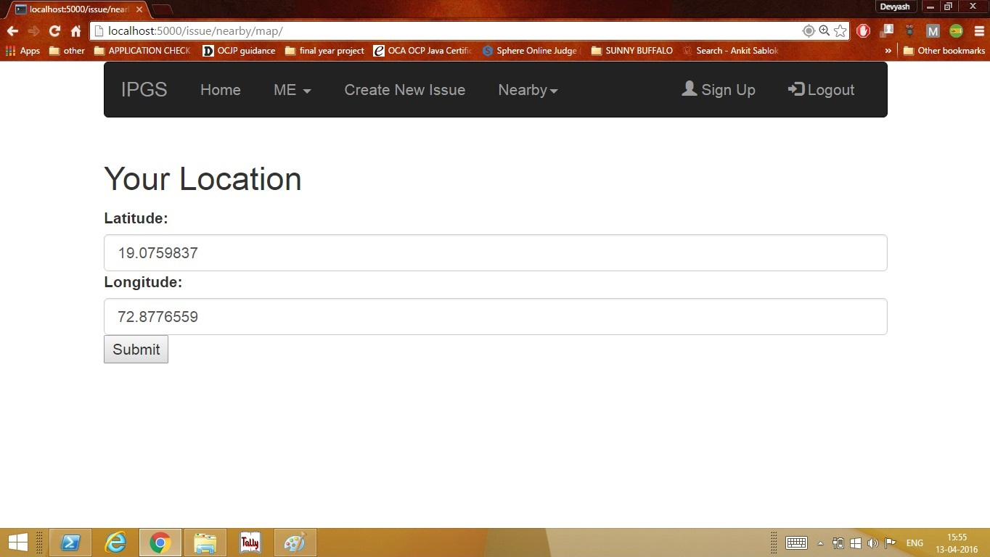
Nearby Issues:
The Webapp automatically detects your location and it provides you an option to change it:

Slide 67
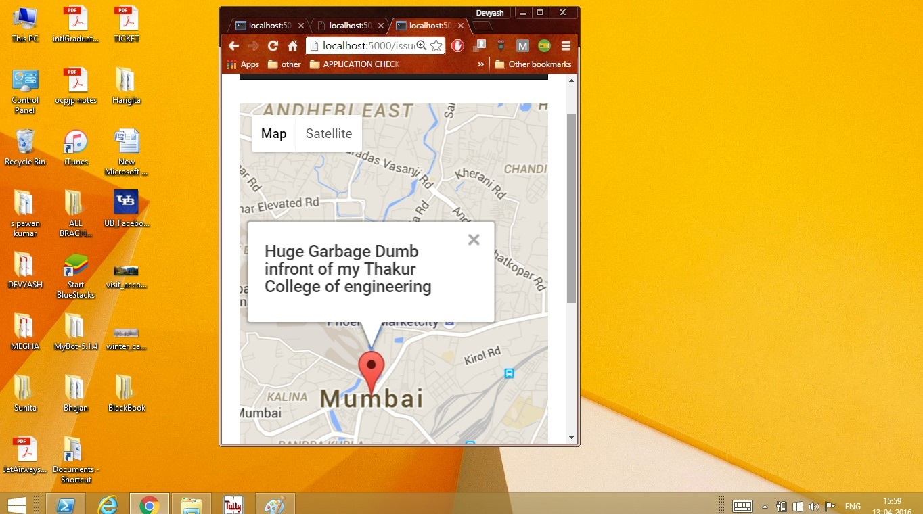
Nearby Issues in Map form (Mobile view)

Slide 68
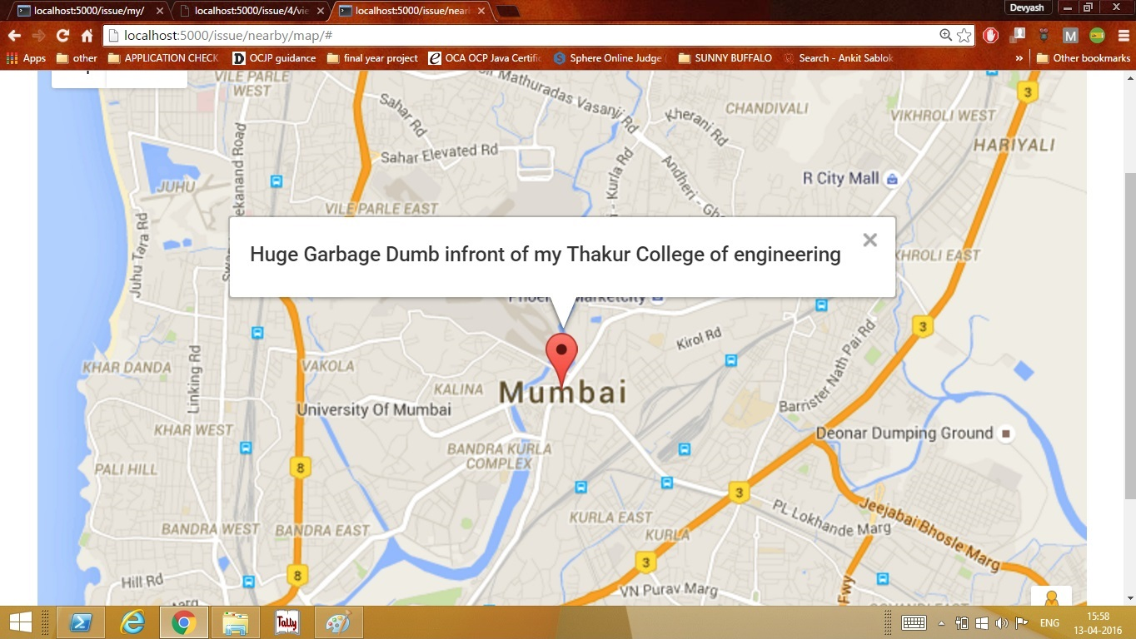
Nearby Issues in Map form (Browser View):

Slide 69

View nearby issues based on location:

Slide 70

EDITING THE USER ISSUE Initial User Complain:

Slide 71


Slide 72
Editing the User Complain:

Slide 73

Anonymous Author:

Slide 74

Changing the author name:

Slide 75

Edited Issue:

Slide 76
CONCLUSION
In summary,
Satisfaction Prediction: Citizens of a city are satisfied with the working of the civic department and governments can be predicted.
2. People have predispositions about Mumbai being an unhealthy and a polluted city which is not true.
3. If the government acts upon user complaints and strives to resolve it with perseverance, Mumbai city can be transformed into a city with clean and healthy environment.

Slide 77
Future work:
This system if successful can be implemented in other cities as well. This system will aim to bring the entire nation under a single platform.
Cooperation of authorities will be a deciding factor in the progress of this system.
Grievances specific to urban cities like menace by illegal hawkers shall also be addressed

Slide 78
THANK YOU

